Slide 1
Listening I want to change my flight
Holidays and Celebrations
Basic 3 Lesson A

Slide 2
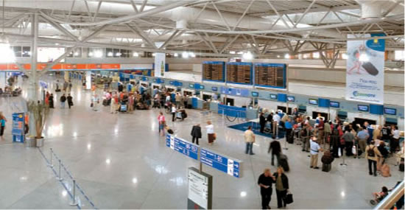

Slide 3
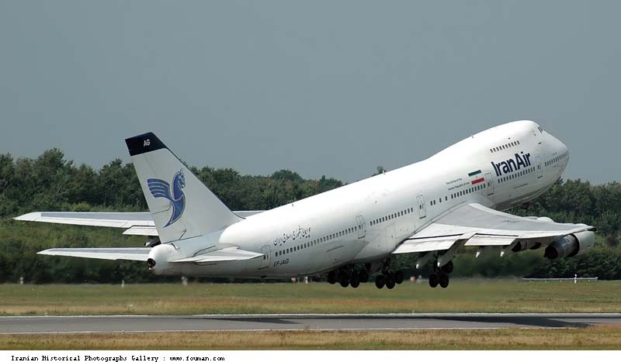
The plane is leaving/departing. Bye!!

Slide 4
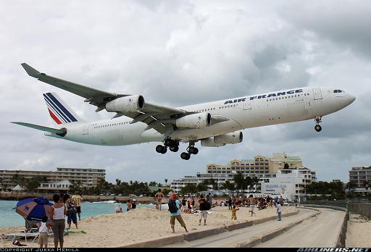
The plane is arriving/returning. Hello!

Slide 5
Where is the person going?
He/She is going to _____(destination)
How is the person traveling?
He/she is traveling by bus/plane/ship.
How much is the fare? (Price of the ticket)
It is ____ dollars.

Slide 6
When is the man leaving(departing)?
He is leaving on _____ (date)
When is the man returning?
He is returning on _____ (date)

Slide 7
When is the man leaving(departing)?
He is leaving on _____ (date)
When is the man returning?
He is returning on _____ (date)
How much is the new ticket?
It is _____ dollars

